Slide 1
Credit Consumption
Team - ML Saints

Slide 2
Problem Statement
Predict the customers average spending for the month of July, August and September

Slide 3
Why solve this problem?
Business impact:
-To Identify the following question
How many times does the average customer use their Credit and Debit cards?
Which month sees the most expenditure ?
Where does the average customer invest?
Which card does the average customer prefer for a certain amount?

Slide 4
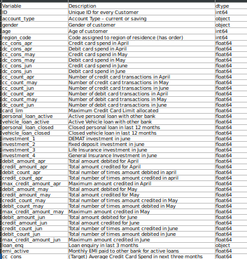
About the Dataset
Dataset Information : The data consists of records of roughly 15000 clients and 44 features. There are 43 predictors and 1 target that describes the spending behaviors of customers.

Slide 5
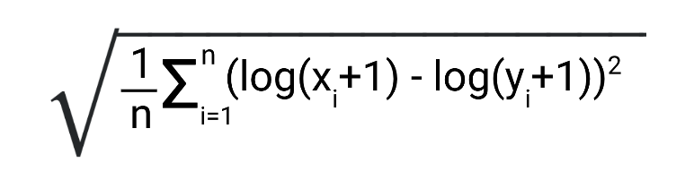
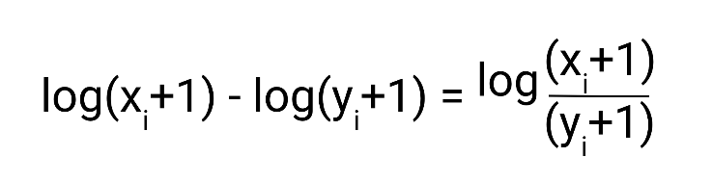
Evaluation Metric
RMSLE-
Relative Error
Biased Penalty
Robustness to the effect of outliers

Slide 6
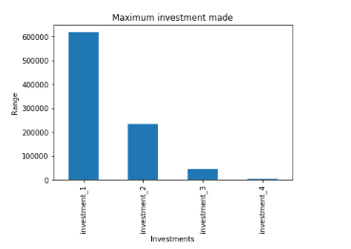
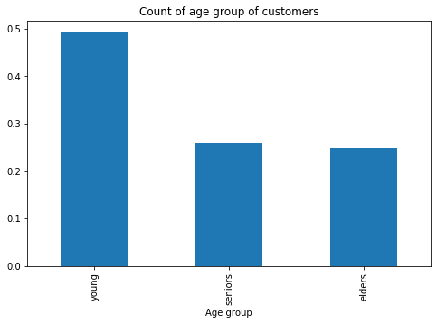
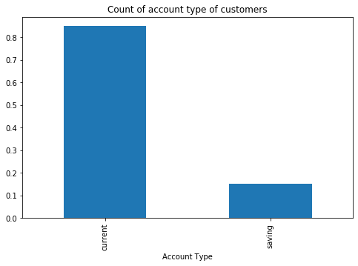
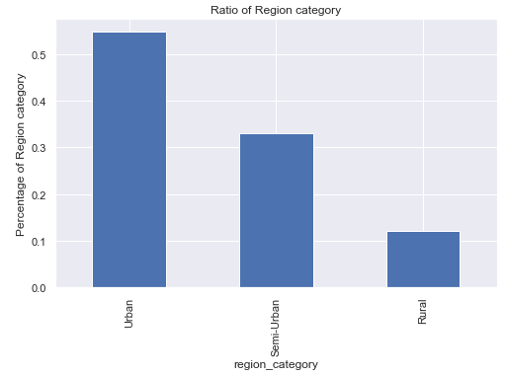
Univariate Analysis

Slide 7
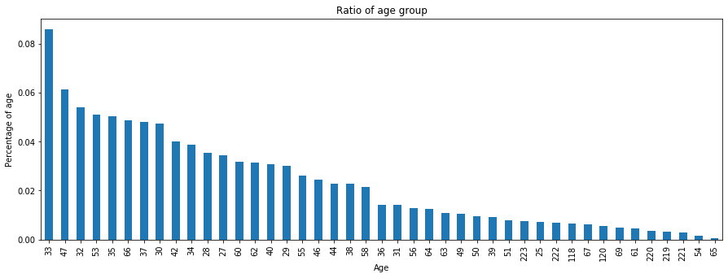
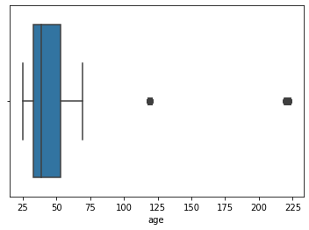
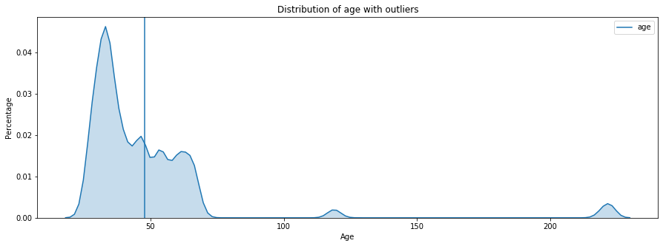
Age
Outliers
Age Group

Slide 8
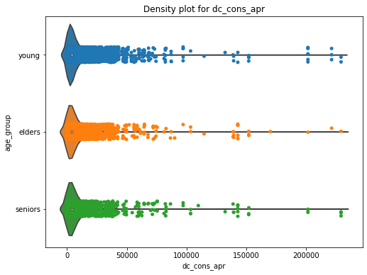
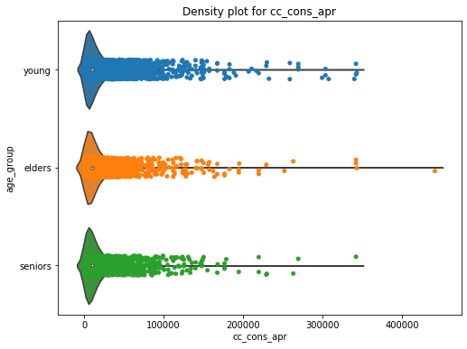
Credit card usage
Division-
Young (25 - 40)
Elder (40 - 55)
Senior(55 - 70 )
Younger customers spend more
Credit card users spend upto 40 lakhs
Credit card use decreases beyond a transaction of 10 lakhs

Slide 9
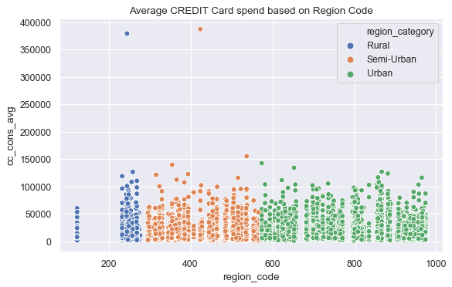
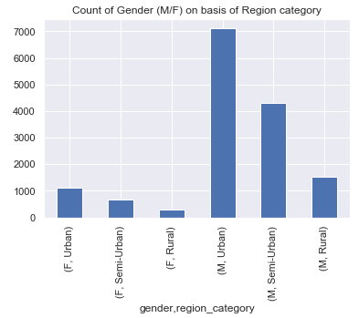
Region
More male customers from Urban and Semi-Urban areas.
Urban customers spend above 50000
Semi Urban spend upto 50000

Slide 10
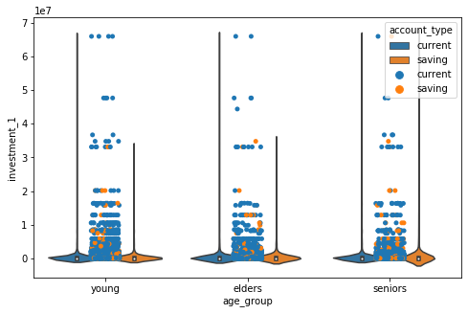
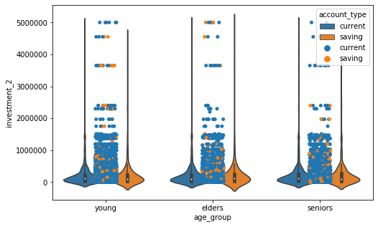
Investment
Current account users tend to make more investment in Demat.
Elders with savings account tend to make bigger investments in Demat.

Slide 11
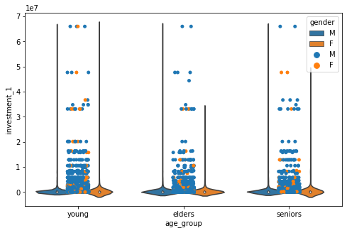
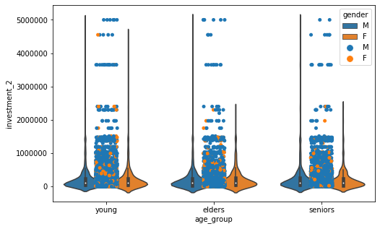
Investment
Gender-
Customers from all age groups invest in fixed deposit but only upto 15 lakh.
Female customers are not as frequent in investing both the categories.

Slide 12
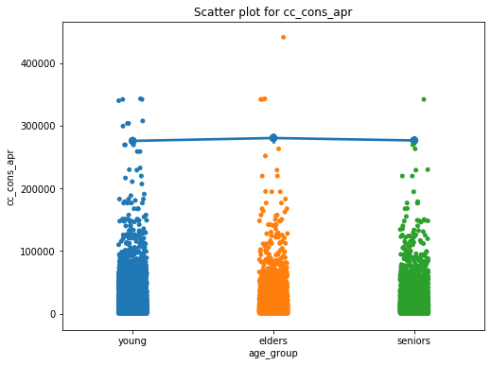
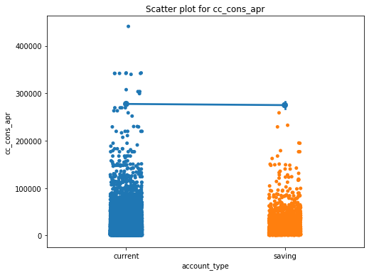
Card limit
Customers with savings account expend below the card limit.
More younger customers tend to use credit card beyond the card limit compared to other two categories.

Slide 13
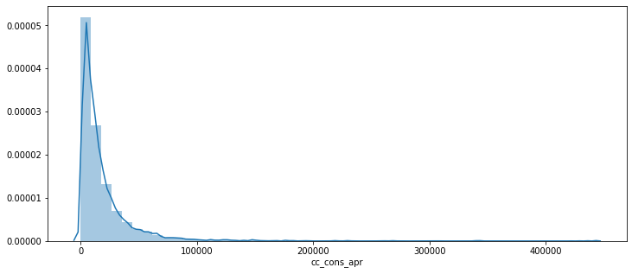
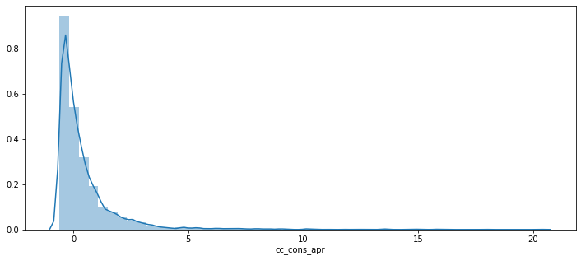
Feature Scaling
Log(x+1)-
Right skewed data
Large separated data values
Helps in evaluating data with small magnitude

Slide 14
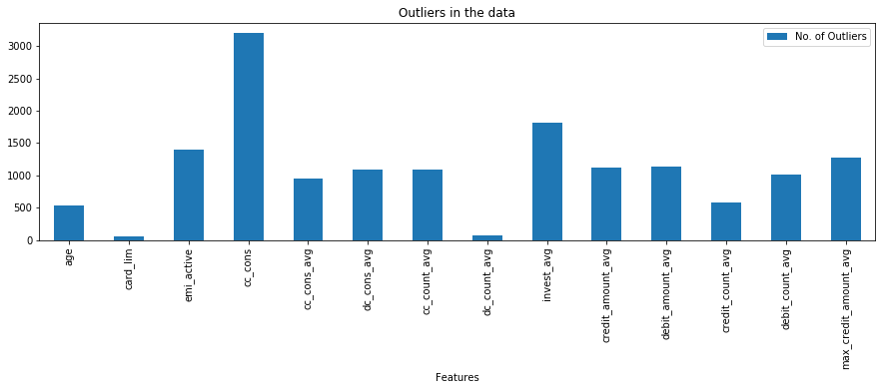
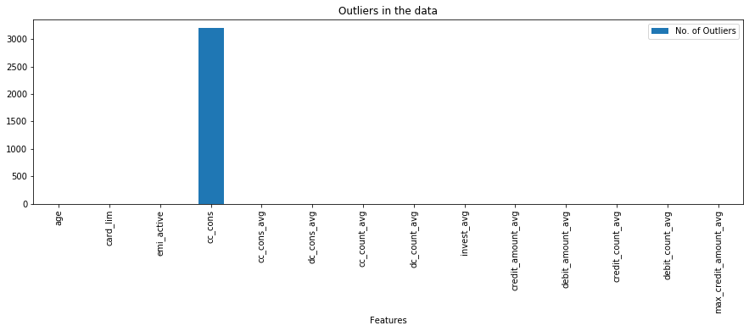
Pipeline
Outlier Treatment:
The Outliers in the continuous features were detected and treated using a method called Winsorization

Slide 15
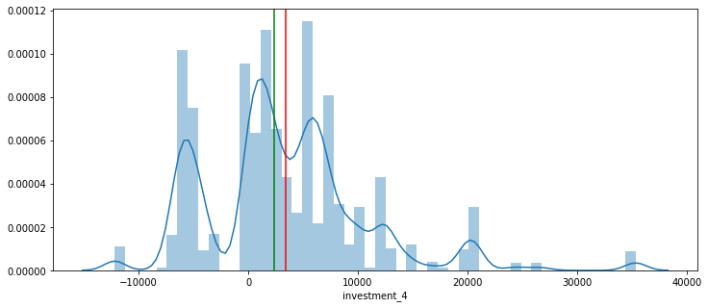
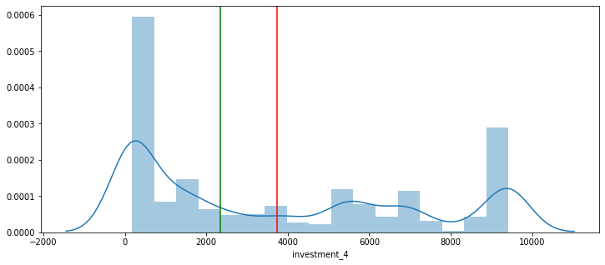
Winsor method of treatment
Range for most columns - quantile(0.15,0.15)

Slide 16
Feature Engineering
Creating new features for the average of -
Credit card
Debit card
Transactions
Credit and Debit amounts
Maximum credit amount
Investment
Dropping features representing each month

Slide 17
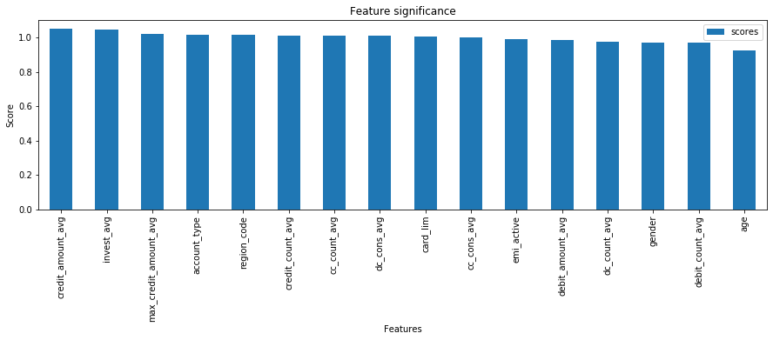
Feature Selection and Missing Values
Following methods were used for feature selection :
RFE
'credit_amount_avg',
'invest_avg',
'max_credit_amount_avg',
'account_type',
‘region_code'
ANOVA
There are no missing values in the continuous feature
Dropped features -
Vehicle loan active and closed
Personal loan active and closed

Slide 18
Models Assessed
Sr. no. | Model | RMSLE score
1 | Linear Regression | 0.1446
2 | Lasso Regression | 0.1493
3 | Ridge Regression | 0.1593
4 | Grid (Ridge) model | 0.1593
5 | Top_k_RFE model | 0.1481

Slide 19
Insights
Customers to be targeted-
Age : 25-40
Investment : Demat and Fixed
Female Customers
Customers with less count of credit transactions
Customers with high credit amount

Slide 20
THANK YOU

